Slide 1
Currency Convertor Program
Jackie Fine
Manav Joshi
Yu Hucong
Kanishk
Titiksha Amol Desai

Slide 2
Introduction
Purpose : Facilitates the conversion of currency amounts between different countries. Achieved by utilizing predefined conversion rates stored within the program.
Functionality : Users can select currency they wish to convert from a list of available options (Dollar, Rupee, Euro, Pound, Yen) and input the amount they want to convert.
Simplicity : The program is designed with simplicity that ensures user can perform currency conversions without encountering any difficulty.
Intuitive Interface : The UI guides user through the conversion process, minimizing the needs for instructions.

Slide 3
Program Overview
CurrencyConverter Class : The class with the basic functionality required for currency conversions. It contains methods for converting currencies and a static HashMap to store conversion rates.
HashMap For Conversion Rates : Within the CurrencyConvertor class HashMap is used to store conversion rates for different currencies. Each entry in the map consist of a currency conversion description as key and the corresponding conversion rate as value.
Static Initialization Block : Is a basic initialization block that is static. This block initializes HashMap with key-value pairs that represent various currency conversion rates.
Main Method Structure : The main method starts the program by displaying a currency menu and prompting user to enter amount to convert. It then calls the convertCurrency method to process the conversion using the conversionRates HashMap for accurate rate retrieval.

Slide 4
User Interaction
Currency Menu Display : The program presents a menu showcasing currency options like Rupee, Dollar, Euro, Yen and Pound offering users a visual reference for their conversion choices.
Selection Prompt : Users are prompted to select their desired currency conversion choice numerically making an easy user interaction with the program.
Amount Input : Upon currency selection, users need to enter input the amount they want to convert over the console and the program will convert amount into the desired currency user selected.
Conversion Invocation : Once the currency and amount are provided, the program invokes the convertCurrency method, initiating the conversion process based on the user's inputs, ensuring smooth execution of the currency conversion.

Slide 5
Conversion Method
Parameters Description : The convertCurrency method takes two parameters: fromCurrency, representing the currency to convert from, and amount, indicating the amount to convert serving as inputs for the conversion process.
Iteration through conversionRates Map : Within the method, a loop iterates through the conversionRates map to find the appropriate conversion rate based on the fromCurrency ensuring the program accurately identifies the conversion rate corresponding to the selected currency.
Retrieval and Calculation : Upon finding the conversion rate for the fromCurrency, the method retrieves the rate from the map and utilizes it to calculate the converted amount by multiplying the amount by the conversion rate ensuring the accurate conversion of currency amounts based on the predefined conversion rates stored in the map.

Slide 6
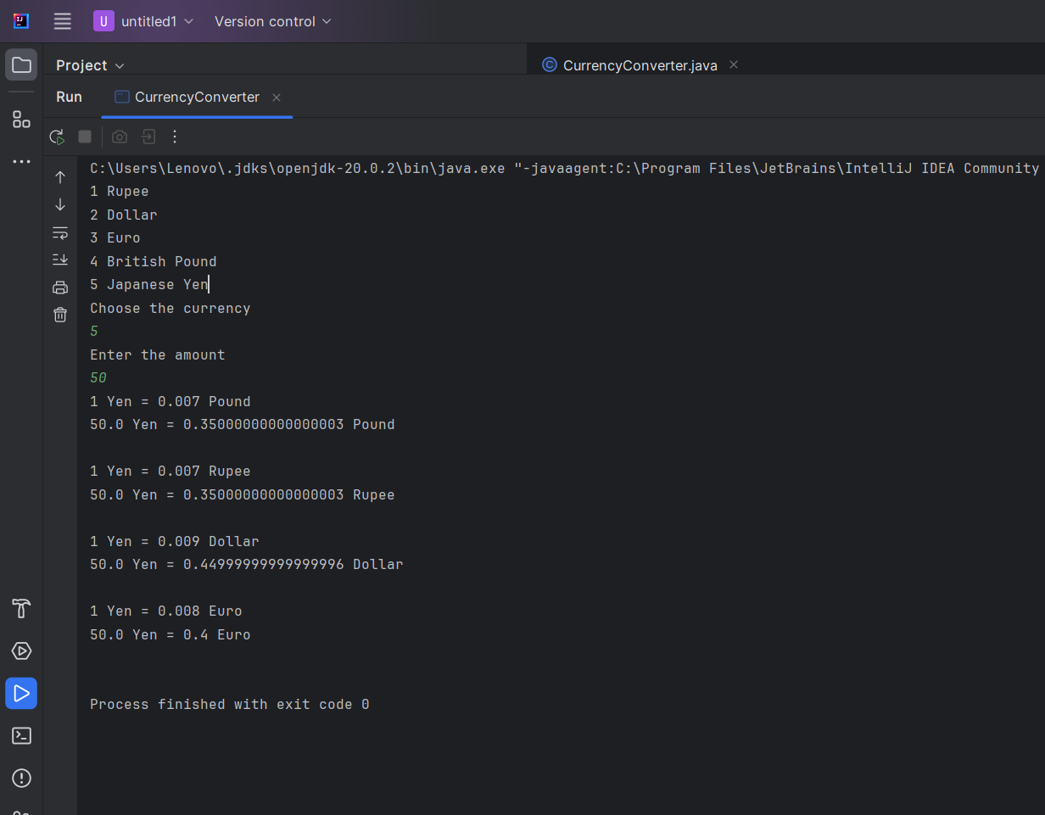
Sample Execution

Slide 7
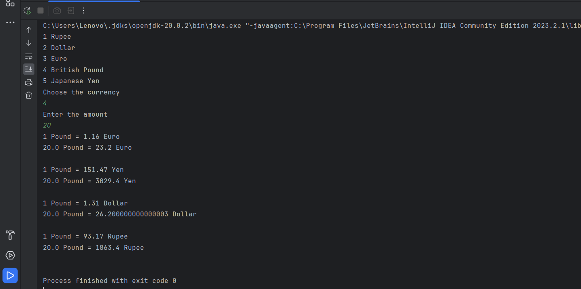

Slide 8
Conclusion
Simplicity and Usefulness : The Currency Converter offers a simple and efficient way to convert currencies.
Encouragement for Exploration : Users are encouraged to explore the program's efficiency enhancing the understanding and confidence in currency transactions.
Emphasis on Accessibility : The Currency Converter welcomes users from all background empowering effortless financial transactions.

